Slide 1
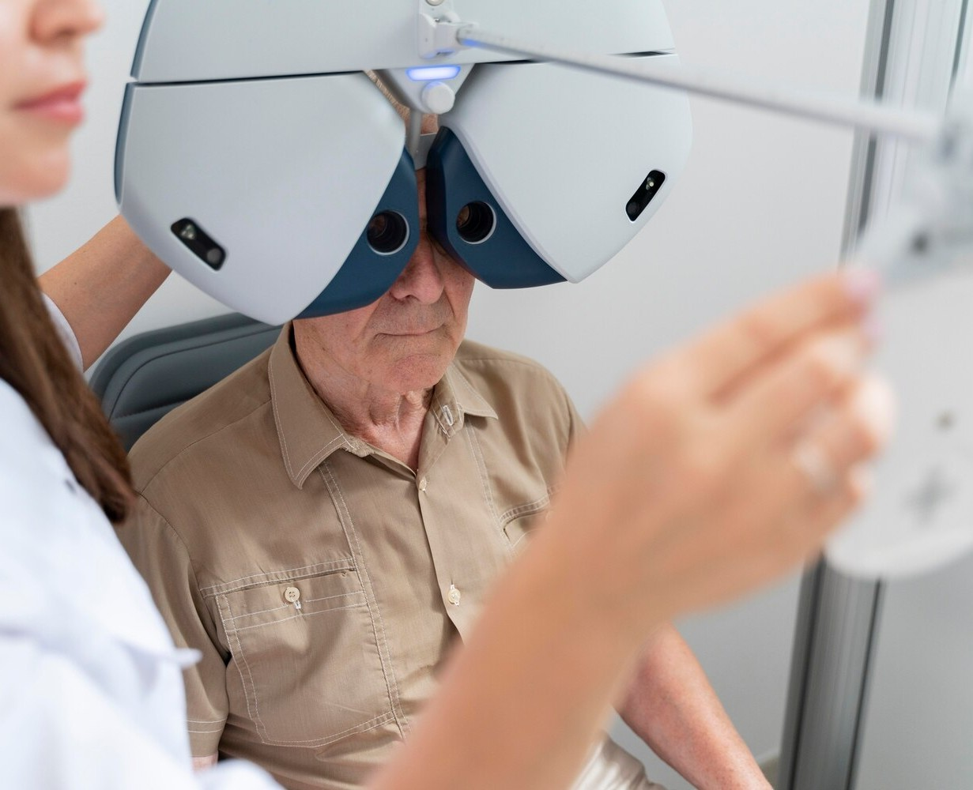
RETINAL DISEASES DETECTION USING DEEP CNN
CH TAPAN - 20R21A6711
D.DANIEL - 20R21A6714
I.KAVYA SRI - 20R21A6728
B.LIKHITHA REDDY - 21R25A6702

Slide 2
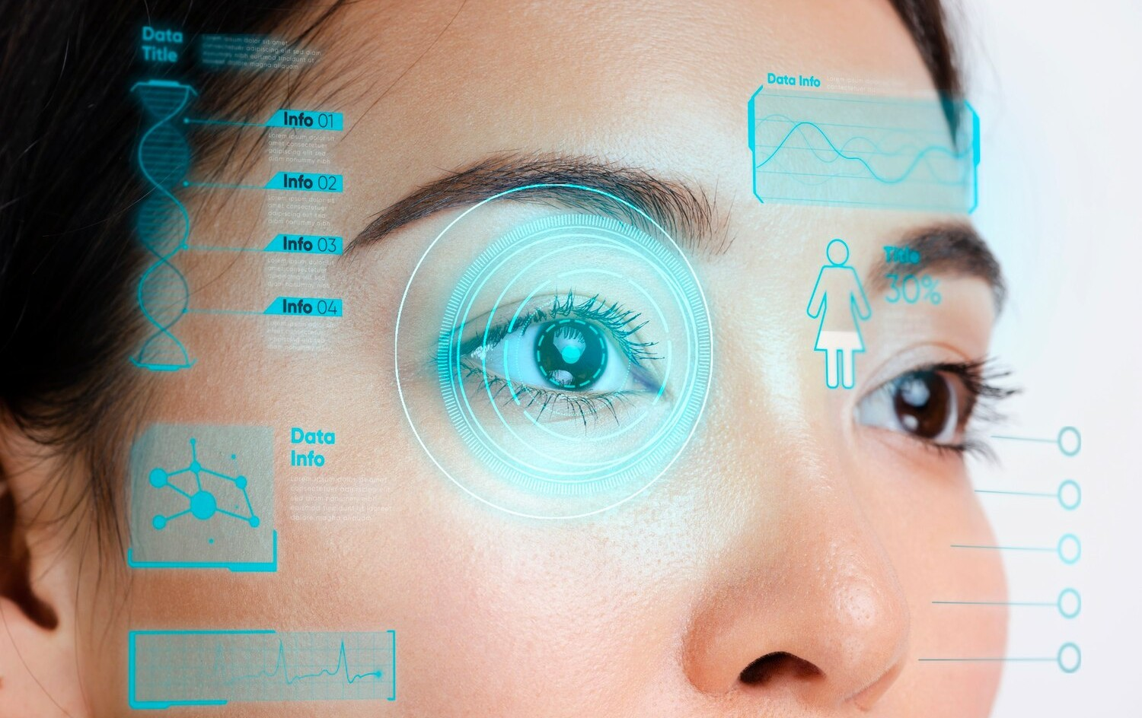
INTRODUCTION
Retinal diseases affect vision and are particularly challenging due to the retina's complexity. The project leverages advanced technology for early detection of diseases like AMD and DME. Experienced ophthalmologists are often needed for accurate diagnoses of diverse retinal conditions. The project harnesses machine learning for improved detection and treatment of retinal diseases. Deep learning models, including CNN is proposed for enhancing memory efficiency and accuracy in disease diagnosis

Slide 3
ABSTRACT
In the identification and classification of critical diseases, Artificial Neural Networks (ANN), Deep learning, Recurrent Neural Networks (RNN), Alex Net, and ResNet can be viewed as a broad research direction. CNN and its specific variant, commonly known as U- Net Segmentation, have revolutionized the classification of medical diseases, specifically retinal diseases. Due to the complexity of feature extraction, U-Net has a significant memory and CPU consumption error when transferring the entire feature map to the corresponding decoder. In addition, combining it with the unsampled decoder feature map prevents the reuse of pooling indices. In this work, we proposes a convolutional neural network (CNN) model for multi-class classification problems with the efficient use of memory consumption. The proposed model has been evaluated on a standard benchmark dataset of Eye Net, having 32 classes of retinal diseases. From experimental evaluation, it has been concluded that the proposed model performs better regarding memory management and accuracy. The overall comparison has been performed based on precision, recall, and accuracy with different numbers of epochs and time consumption by each step. The proposed technique achieved good accuracy on the Eye-net dataset.

Slide 4
OBJECTIVES
Accurate Disease Classification: Develop a model that can accurately classify retinal diseases into multiple classes, such as diabetic retinopathy, macular degeneration, and others.
Deep CNN Architecture: Design a deep CNN architecture tailored for retinal disease detection, considering factors like receptive field, filter size, and network depth to enhance feature extraction.
Memory Efficiency: Optimize the model to minimize memory consumption, enabling deployment on resource-constrained devices, ensuring practical usability in real-world settings.
Data Preprocessing: Implement effective preprocessing techniques for retinal images, such as normalization and augmentation, to enhance the model's ability to generalize and detect diverse patterns.
5. Transfer Learning: Explore transfer learning approaches using pre-trained models to leverage
knowledge from large datasets, particularly beneficial when working with limited medical imaging data.

Slide 5
EXSISTING SYSTEM
In literature they introduces a deep learning-based automated detection and classification model for fundus DR images.
Their method involves various processes namely preprocessing, segmentation and classification.
Their methods begins with preprocessing stage in which unnecessary noise that exists in the edges is removed. Next, histogram-based segmentation takes place to extract the useful regions from the image.
Then, Synergic Deep Learning (SDL) model was applied to classify the DR fundus images to various severity levels.
The justification for the presented SDL model was carried out on Messidor DR dataset.

Slide 6
PROPOSED SYSTEM
We proposes a convolutional neural network (CNN) model for multi- class classification problems with the efficient use of memory consumption.
The proposed model has been evaluated on a standard benchmark dataset of Eye Net, having 32 classes of retinal diseases.
The deep learning-based CNN model has been applied for retinal-based crucial diseases to boost the conventional diagnostic method.
The proposed CNN model compares with standard state-of-art techniques. The overall comparison has precision, recall and accuracy with different numbers of epochs and time consumption by each step.

Slide 7
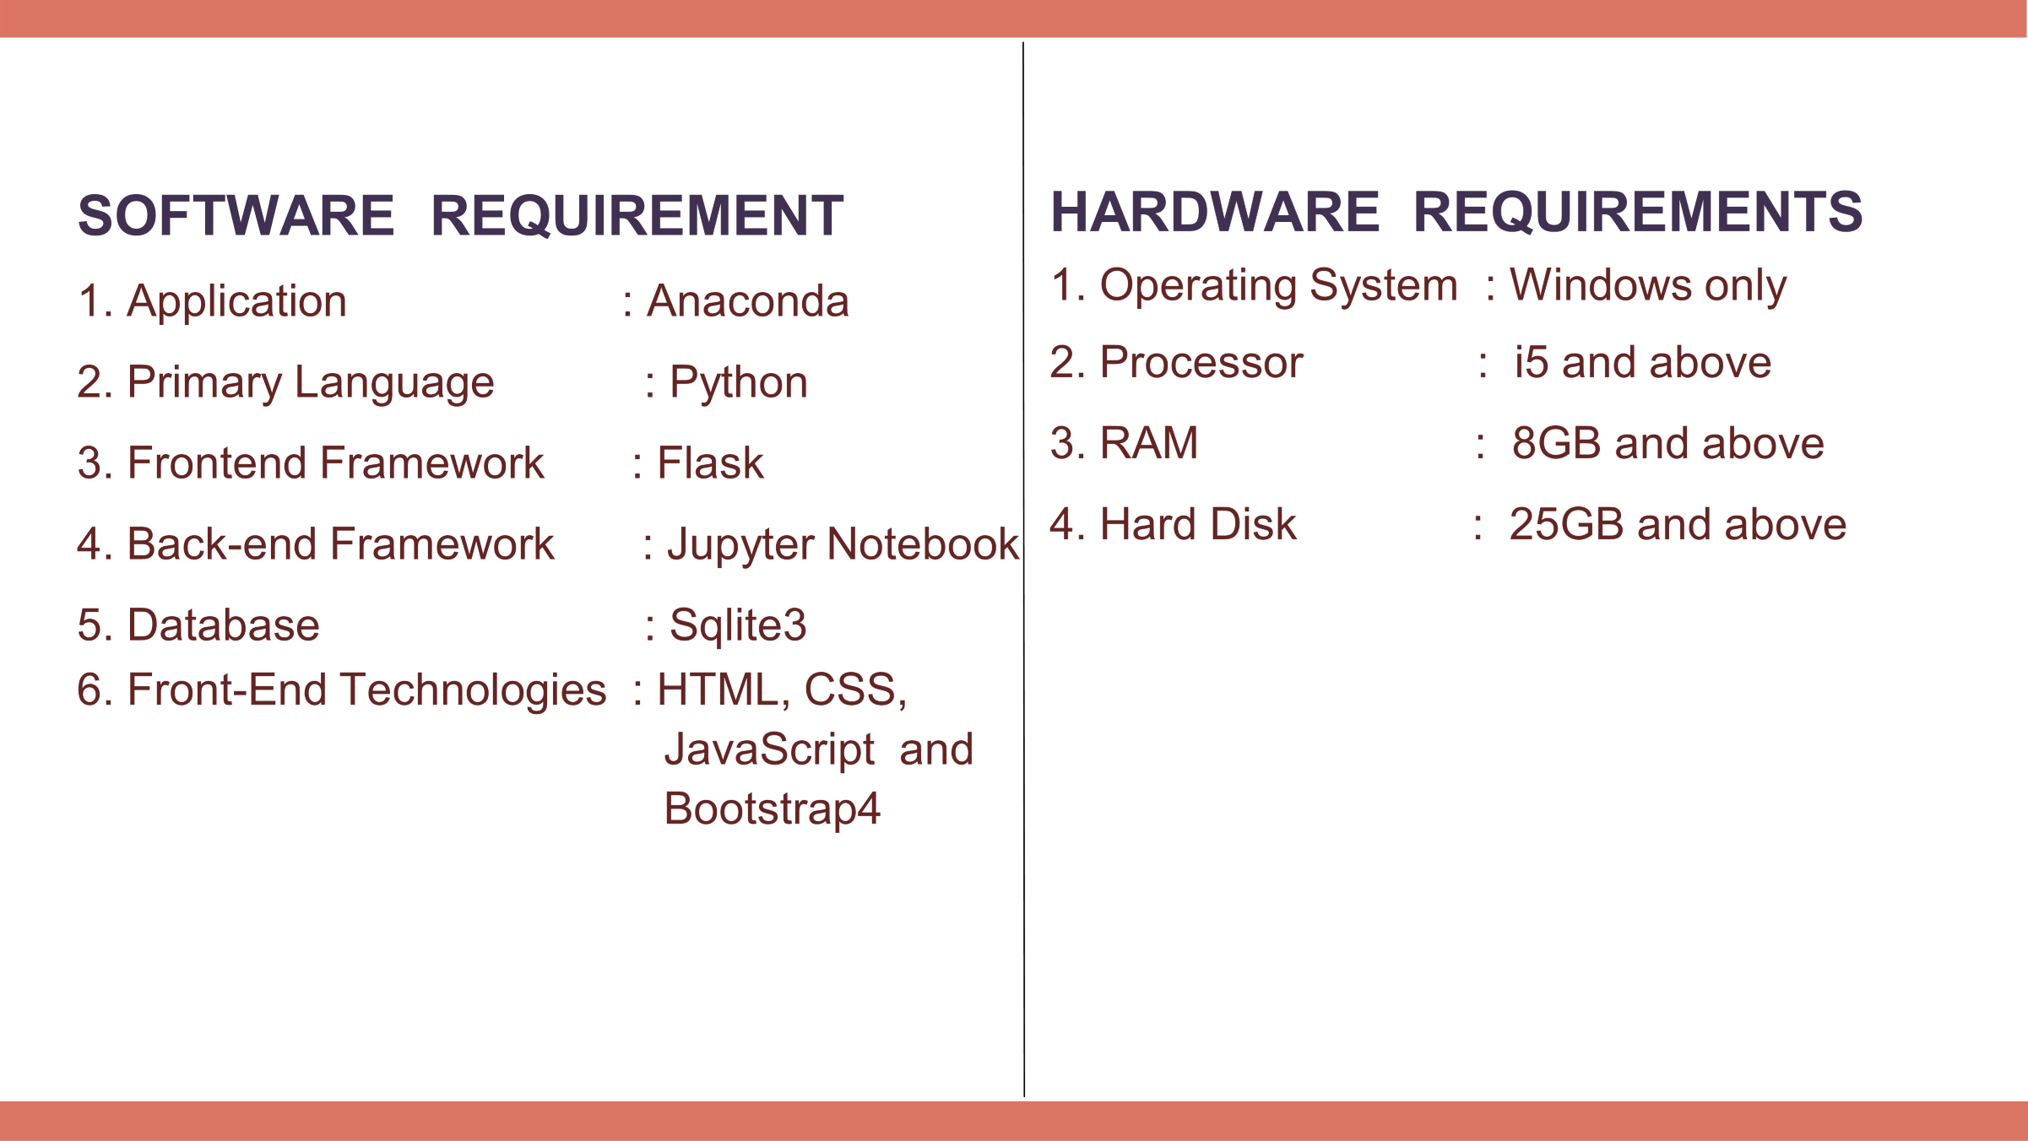

Slide 8
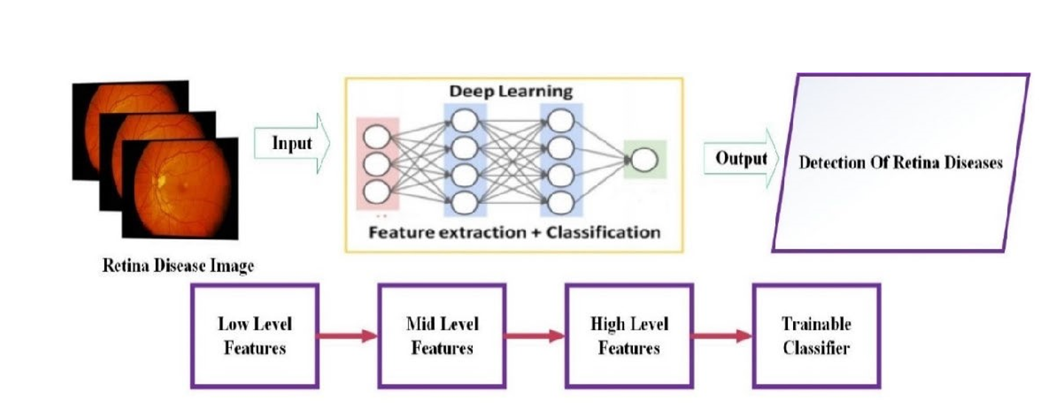
SYSTEM ARCHITECTURE

Slide 9
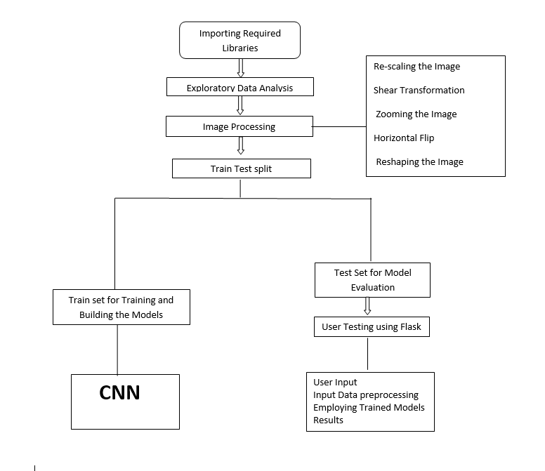
DATA FLOW
Extension MobileNet
Extension Xception
CNN
UNet(CNN) + SVM
Extension MobileNet+ Xception

Slide 10
FLOW OF WORK
1. Importing the packages
2. Exploring the dataset - EyeNet Master
3. Image processing - Using Image Data Generator
Re-scaling the Image
Shear Transformation
Zooming the Image
Horizontal Flip
Reshaping the Image
4. Building the model
5. Training the model
6. Flask Framework with SQLite for signup and signin

Slide 11
FLOW OF WORK
7. User Upload an image for analysis
8. The given input is preprocessed
9. The trained model is used for predicting the result
10. Final Outcome is display

Slide 12
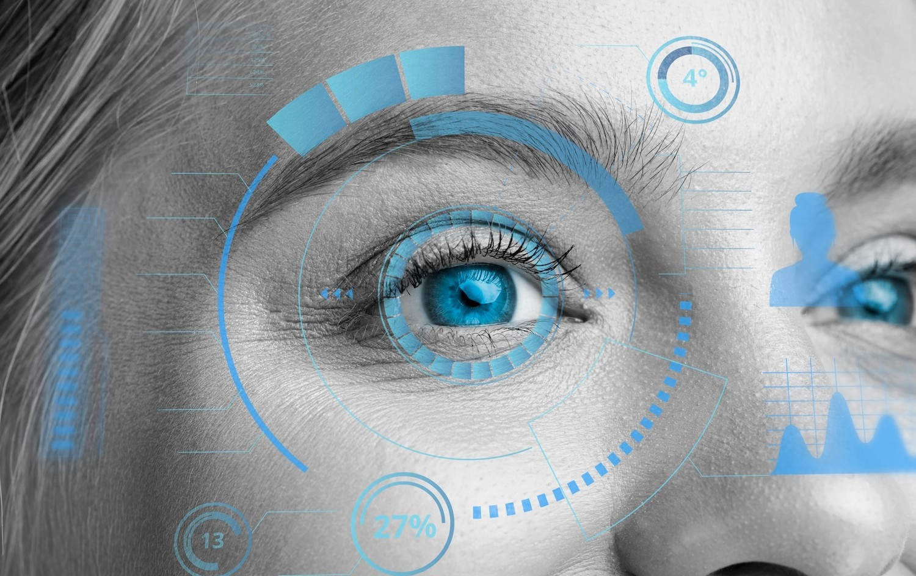
ALGORITHMS USED
Extension MobileNet
Extension Xception
CNN
UNet(CNN) + SVM
Extension MobileNet+ Xception

Slide 13
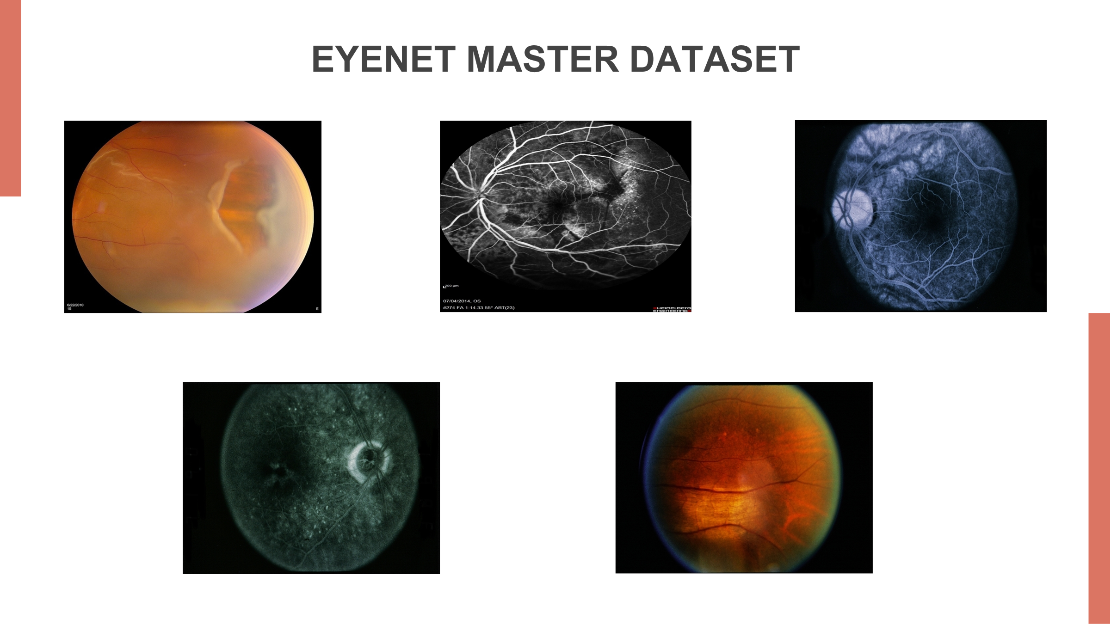

Slide 14
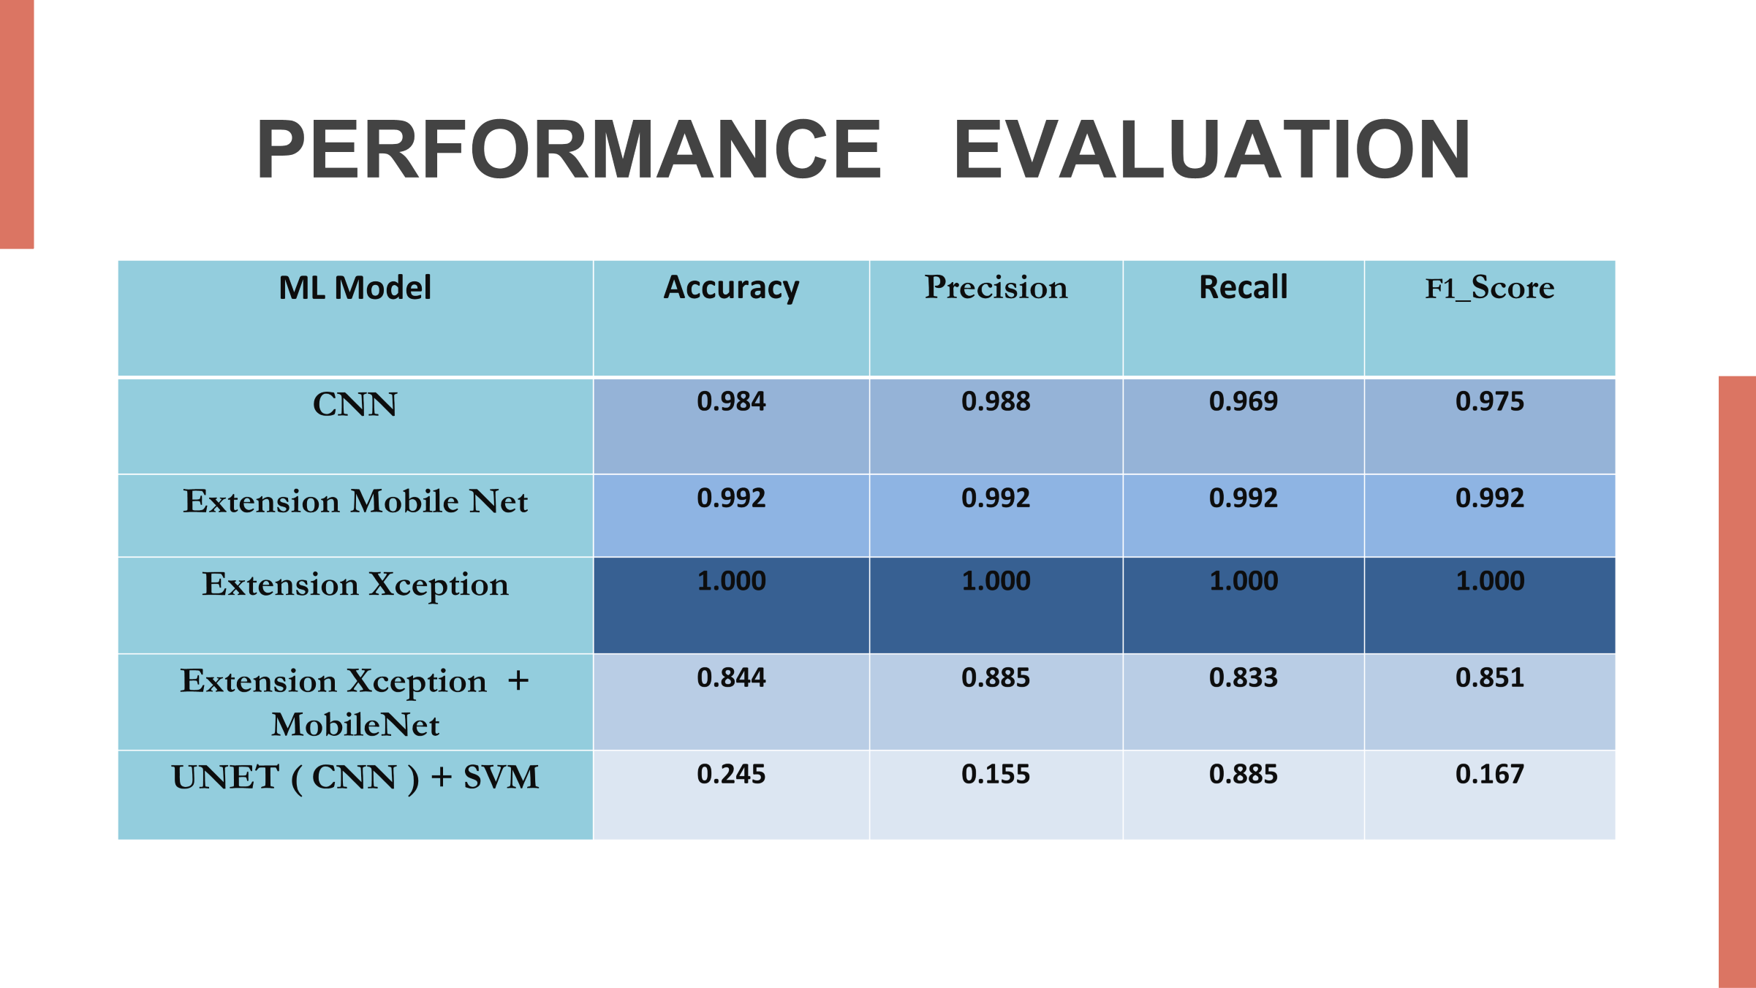

Slide 15
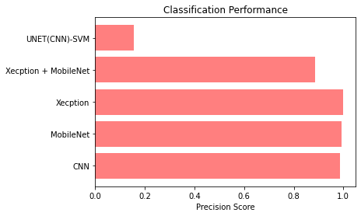
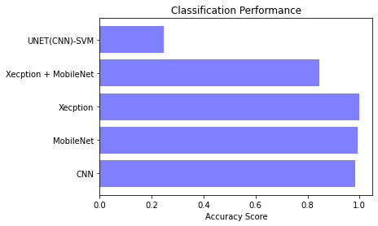
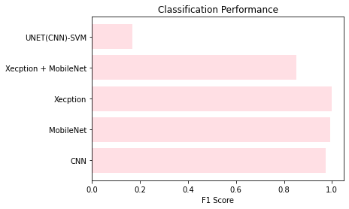
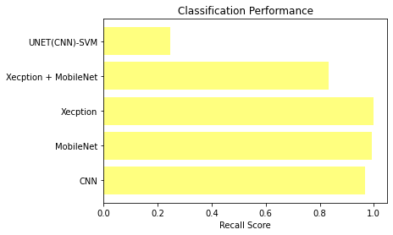
COMPARISON GRAPHS

Slide 16
CONCLUSION
The CNN model achieved high accuracy on the Eye-net dataset, demonstrating its efficient and accurate classification of retinal diseases.
It outperformed existing techniques in memory management and accuracy, evaluated using precision, recall, and different training times.
The remarkable accuracy of MobileNet and Xception in retinal disease classification solidifies their exceptional performance, positioning them as leading contenders for advancing medical image classification.
Performance evaluation was done by comparing model output to ophthalmologist-provided labels, confirming its effectiveness.
Using Flask for the front-end allowed focused evaluation of our top-performing algorithms, providing systematic validation through user inputs

Slide 17
FUTURE SCOPE
Expanding the model to include more disease classes will broaden its diagnostic capabilities, making it more comprehensive and versatile.
Ongoing research can focus on reducing memory consumption, ensuring the model is more resource-efficient, and suitable for real-time applications.
Seamless integration with medical imaging systems will facilitate accurate and efficient retinal disease diagnosis by assisting healthcare professionals.
Collaborative efforts with medical experts will refine the model and validate its performance on diverse datasets, increasing its credibility in clinical practice.

Slide 18
THANK YOU

